Slide 1



REAL TIME TRAFFIC PREDICTION
Team Members: Guide: Jay Rathod
Sujal Padiya(21IT471)
Het Vaishnav(21IT448)
Chauhan Bhavesh(21IT451)

Slide 2
OUTLINE
Abstract
Problem Statement
Aims, Objective & Proposed System/Solution
System Design/Architecture
System Development Approach (Technology Used)
Algorithm & Deployment
Conclusion
Future Scope
References
Video of the Project
Notes:
These are the list of chapters that we are going to cover in these foundation codes. Those are chapter one what are AI and ML? chapter 2 applied Python programming in AI, and chapter 3 is exploratory data analysis for ML.

Slide 3
Abstract
“ Project aims to create a reliable traffic flow prediction system using machine learning. It accurately forecasts traffic conditions using historical data, weather patterns, and real-time inputs for improved traffic management. ”

Slide 4
Problem Statement
Traffic congestion wastes time and resources. This project aims to develop a real-time traffic prediction system using machine learning (like LSTMs) to analyze real-time data and forecast traffic flow, improving commutes through informed route optimization.

Slide 5
Aim and Objective
AIM:
Develop a real-time traffic prediction system using machine learning to improve traffic flow and optimize commutes.
Objectives:
Acquire and preprocess real-time traffic data from Dataset.
Evaluate various machine learning models, potentially including LSTMs and CNNs, for traffic flow prediction accuracy.
Train and optimize a chosen machine learning model for real-time traffic flow prediction.
Design a user-friendly interface to visualize real-time traffic conditions and predicted flow.
Evaluate the effectiveness of the system in improving traffic flow and commute efficiency.

Slide 6
Proposed Solution
Data Acquisition & Preprocessing:
Acquire real-time traffic data and preprocess it for quality
Machine Learning Model Development:
Train and evaluate machine learning models to predict traffic flow.
Real-Time Prediction System Design:
Develop a system for real-time data ingestion and traffic flow prediction using the chosen model.
User-Friendly Visualization & Optimization:
Design a user interface for real-time traffic visualization and route optimization based on predictions.

Slide 7
System Architecture
System architecture encompasses the structure, behavior, and interactions of a system's components. It defines the arrangement of software and hardware elements, guiding the system's design and development. Through layered organization and modularization, system architecture ensures scalability, maintainability, and performance. Technologies, frameworks, and security measures are strategically integrated to meet functional requirements and address challenges. Effective system architecture facilitates efficient deployment, monitoring, and maintenance, ensuring the system's reliability, availability, and security in diverse environments.

Slide 8
System Deployment Approach
1. Planning: Clearly define deployment goals, requirements, and constraints.
2. Continuous Integration and Deployment (CI/CD): Implement automated build, testing, and deployment processes.
3. Deployment Strategy: Choose an appropriate deployment strategy (e.g., blue-green, rolling) to minimize downtime and risk.
4. Monitoring and Health Checks: Implement monitoring and alerting for system performance and availability.
5. User Training and Support: Provide comprehensive training and support resources for users to ensure successful adoption of the system.

Slide 9
Algorithm & Deployment
Linear Regression:
Linear regression is a statistical method used to model the relationship between a dependent variable and one or more independent variables by fitting a linear equation to observed data. In simple terms, it helps us understand how the value of the dependent variable changes when one or more independent variables are varied.

Slide 10
Conclusion
In conclusion, the project successfully demonstrated the effectiveness of linear regression in predicting real-time traffic flow. The accurate predictions obtained hold significant potential for improving traffic management, reducing congestion, and enhancing safety on the roads. While challenges and limitations were encountered, the project's findings provide valuable insights for future research and practical applications in urban planning and transportation management.

Slide 11
Future Scope
1. Integration with Advanced Machine Learning Techniques: Explore the use of advanced machine learning techniques beyond linear regression, such as decision trees, random forests, or deep learning models like LSTM (Long Short-Term Memory) networks, to improve prediction accuracy and account for nonlinear relationships in traffic data.
2. Integration with Real-Time Traffic Data Sources: Enhance the predictive model by integrating real-time traffic data from sources like GPS-enabled vehicles, traffic cameras, and IoT sensors, allowing for more accurate and timely predictions of traffic flow patterns.
3. Deployment of Interactive Visualization Tools: Develop interactive visualization tools or dashboards to present real-time traffic predictions in a user-friendly manner, enabling transportation authorities and commuters to make informed decisions and plan routes accordingly.

Slide 12
Reference
https://github.com/
https://chatgpt.com/c/85806e1b-74fd-43f5-bb89-6daf4e6a9f3c
https://jupyter.org/
Notes:
Reference
These are the references for this session.
12

Slide 13
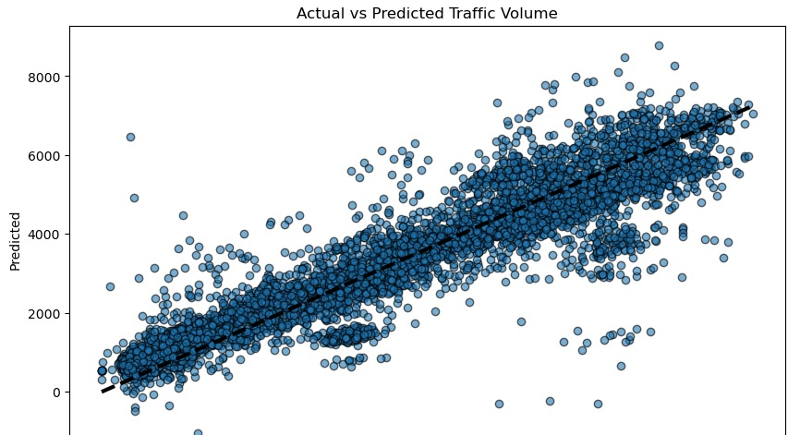

Slide 14
Thank you!
Notes:
thank you very much for joining this PPT, keep learning.
14

